Slide 1
Compilers 101
Intro

Slide 2
Course overview
Intro (this lecture)
Compiler frontend
Static analysis
Intermediate representations
Optimizations
Backend
Debuggers
Heterogeneous compilers

Slide 3
Contacts
Lectures: Оболенский Арсений
E-mail: me@gooddoog.ru
Via portal.unn.ru
Practice: Лычков Михаил
E-mail: mikelitch@gmail.com
GitHub org: https://github.com/NN-complr-tech/Complr-course-lectures

Slide 4
What is a compiler?
Source code
Magic
Executable

Slide 5

First compilers
A-0, 1952
Grace Hopper at Remington Rand
Not a real compiler, functioned more as a loader and a linker
Photo: https://en.wikipedia.org/wiki/Grace_Hopper

Slide 6
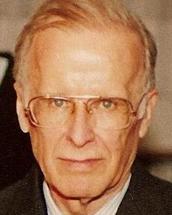
Fortran
1954-1957
John Backus at IBM
Fortran is still used and actively developed by ISO. The last release is Fortran 2018.
Photo: https://en.wikipedia.org/wiki/John_Backus

Slide 7
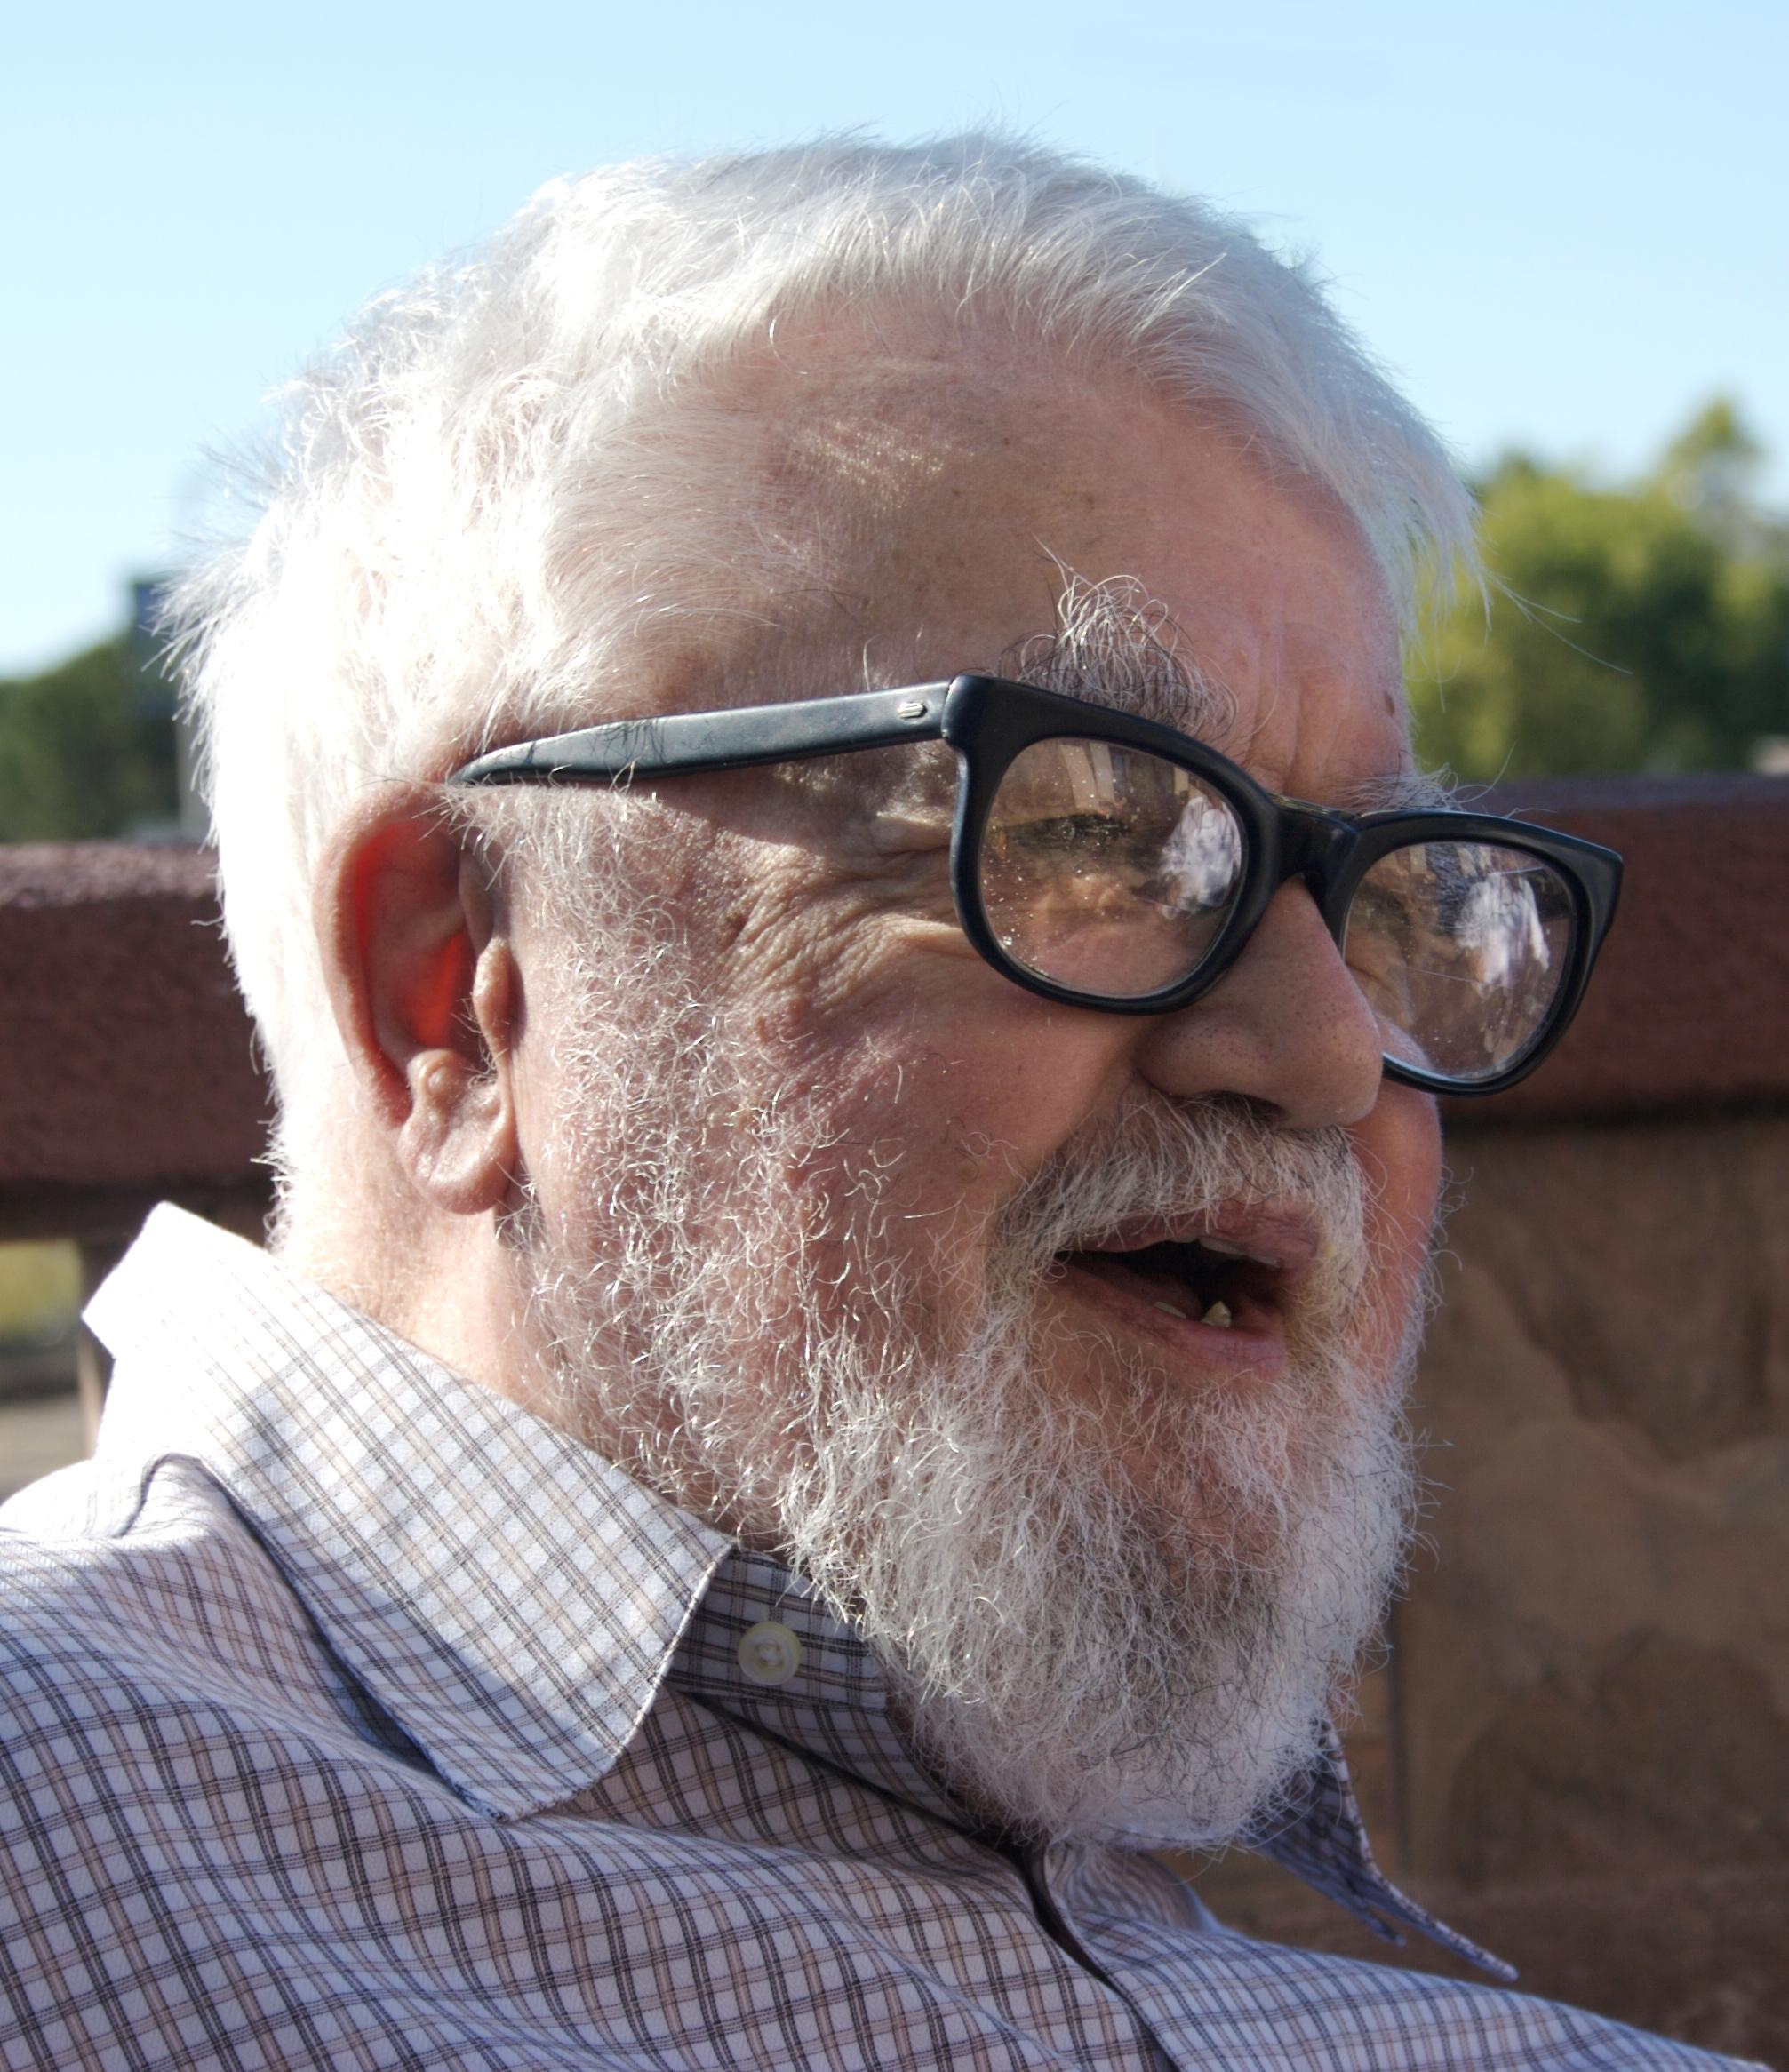
Lisp
1958
John McCarthy at MIT
Second oldest high-level programming language
Photo: https://en.wikipedia.org/wiki/John_McCarthy_(computer_scientist)

Slide 8
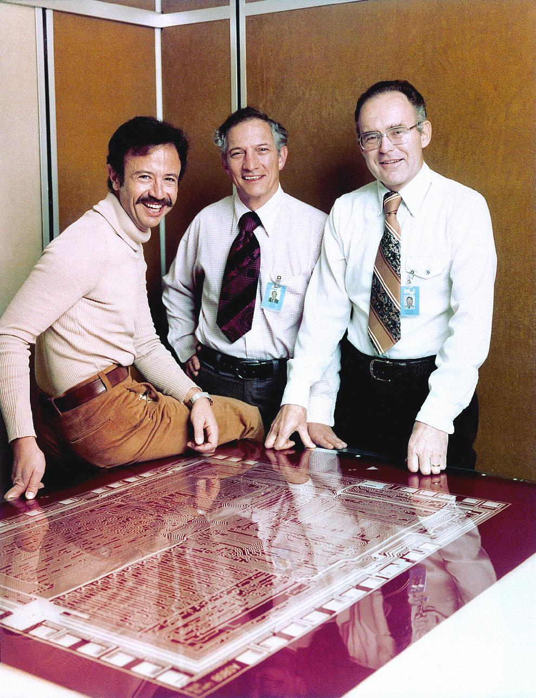
Beyond software
Hardware description languages
Verilog – 1984
VHDL – 1987
OpenCL – 2009
SYCL – 2014
Photo: https://www.flickr.com/photos/intelfreepress/8267616249/in/photostream/lightbox/
Heterogenous calculation languages

Slide 9
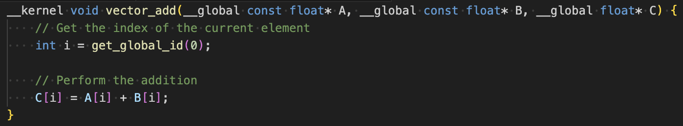
OpenCL
Purpose: Designed for creating programs that leverage the parallel computing capabilities of heterogeneous platforms.
Cross-Platform: Supports a wide range of devices from various manufacturers, including GPUs, CPUs, DSPs, and FPGAs.
Parallel Programming Model: Enables efficient execution of high-performance computing, graphical, and real-time applications.

Slide 10
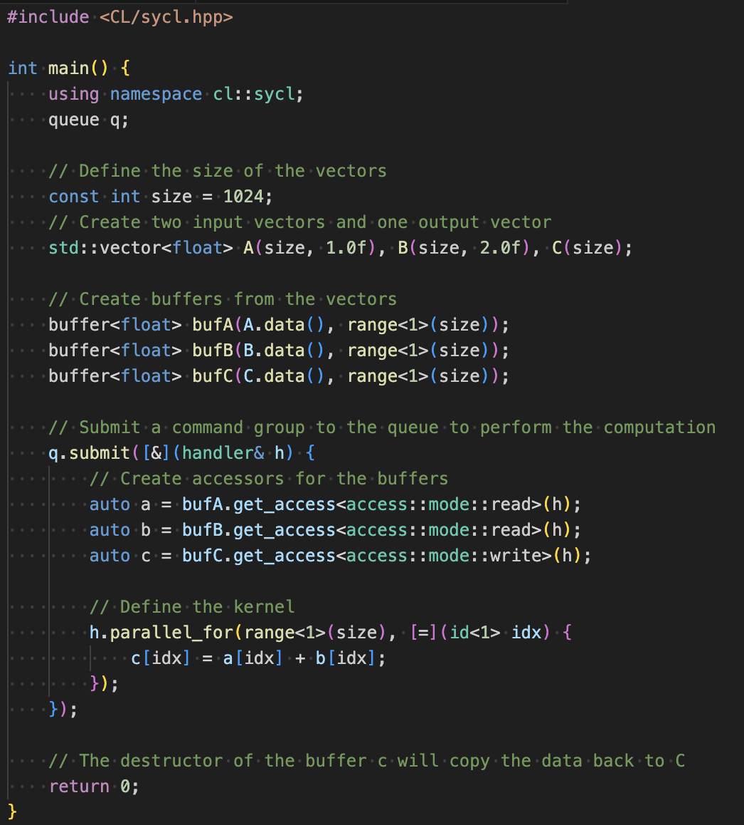
SYCL
SYCL (pronounced "sickle") is a high-level programming model built on top of OpenCL that enables developers to write code for heterogeneous devices (such as CPUs, GPUs, DSPs, and FPGAs) using standard C++.
It abstracts away much of the boilerplate code associated with OpenCL, allowing for easier development of parallel computing applications.

Slide 11
Why study compilers?
Write better software
Compiler is a tool, mastering this tool will help you write fast and reliable software
Compilers are not only about code generation
Static analysis, code-to-code conversion
Example: Intel® DPC++ Compatibility Tool (aka SYCLomatic), https://www.intel.com/content/www/us/en/developer/tools/oneapi/dpc-compatibility-tool.html#gs.p25a6d
Compiler writers get paid!

Slide 12
Course emphasis
Practice oriented
Study modern compiler tooling and infrastructure
Lab assignments
Provide overview of basic algorithms and theory
Non-goal: how to build a complete compiler optimizer
There are lots of links on the slides, make sure to check them out if you want to know more

Slide 13
The rest of this lecture
Hardware architecture refresh
CPUs, GPUs, FPGAs
Just enough to understand the problem
Quick compiler architecture introduction
Overview of practical applications

Slide 14
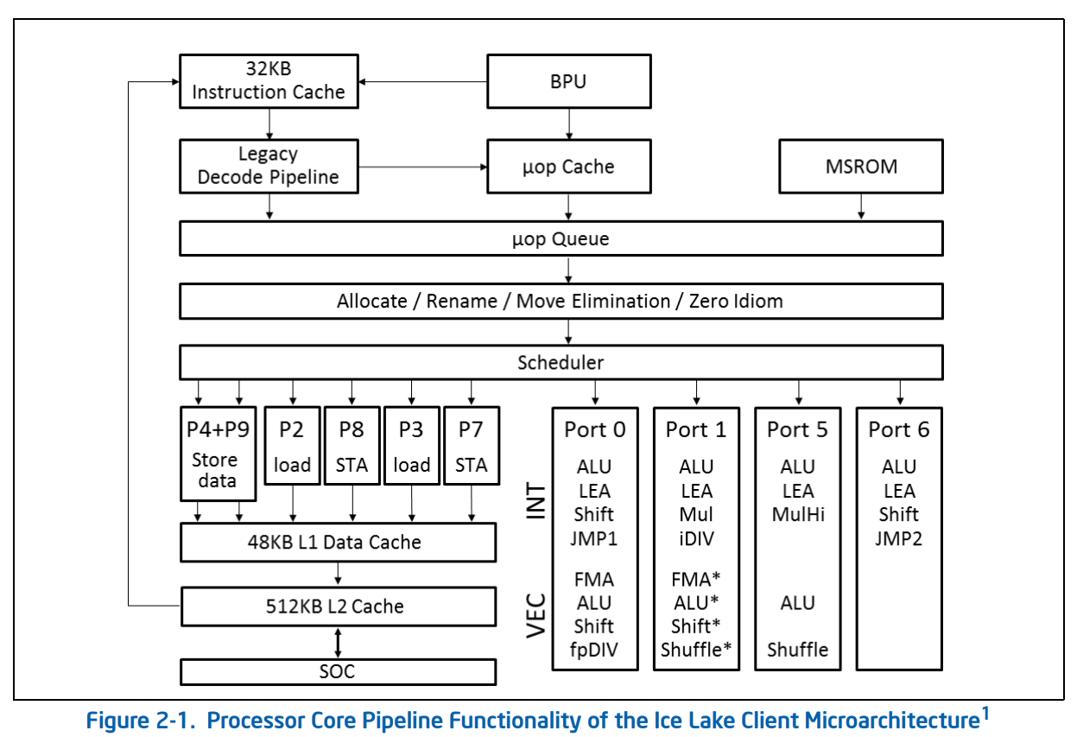
CPUs
https://www.intel.com/content/www/us/en/developer/articles/technical/intel-sdm.html

Slide 15
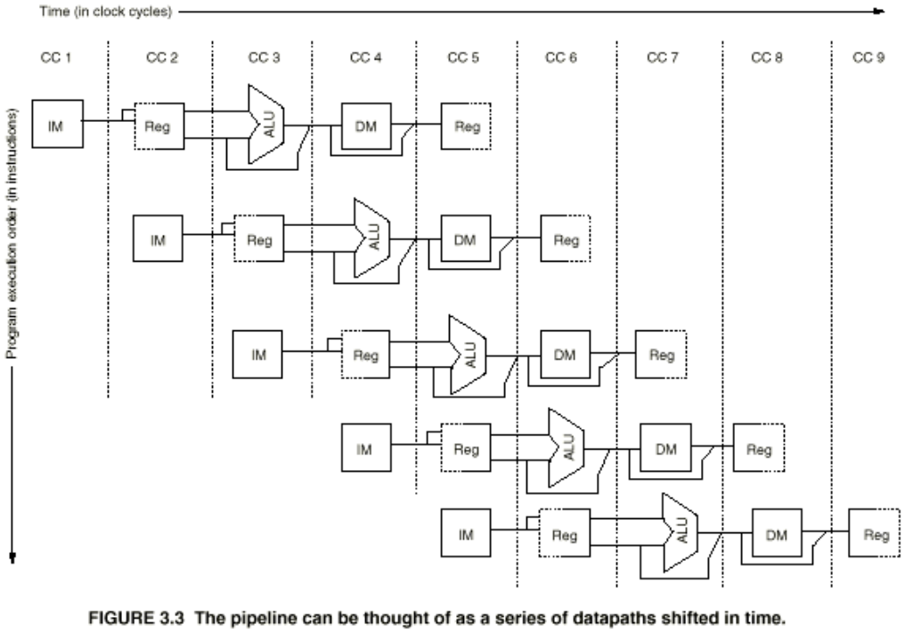
CPU pipeline

Slide 16
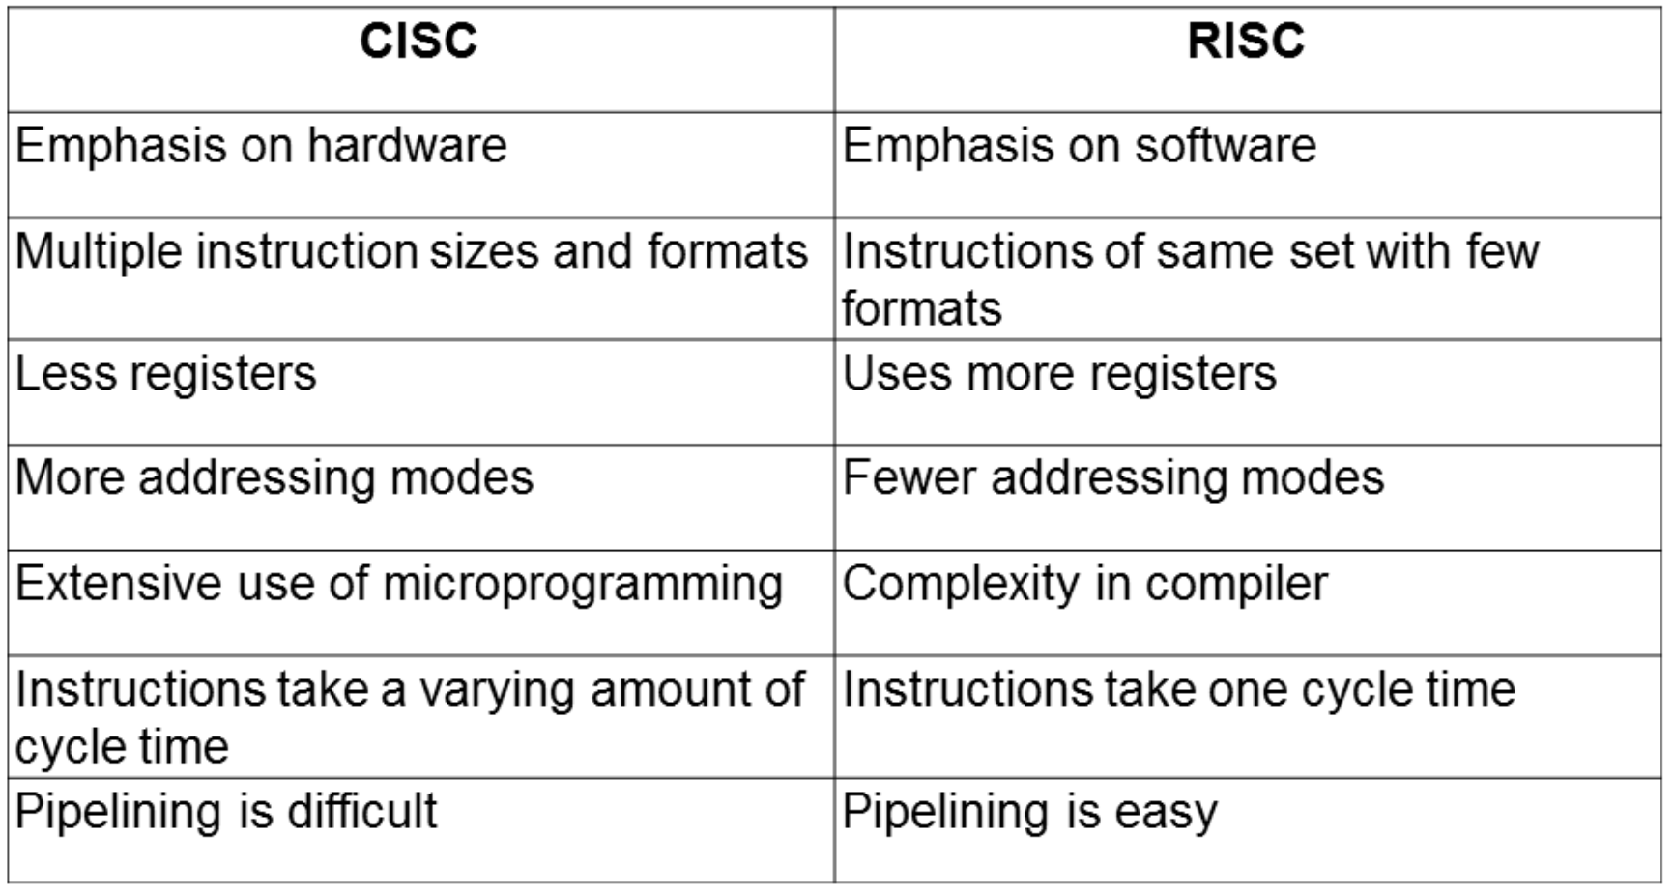
CISC vs RISC
https://csarassignment.files.wordpress.com/2013/05/risc-vs-cisc.png

Slide 17
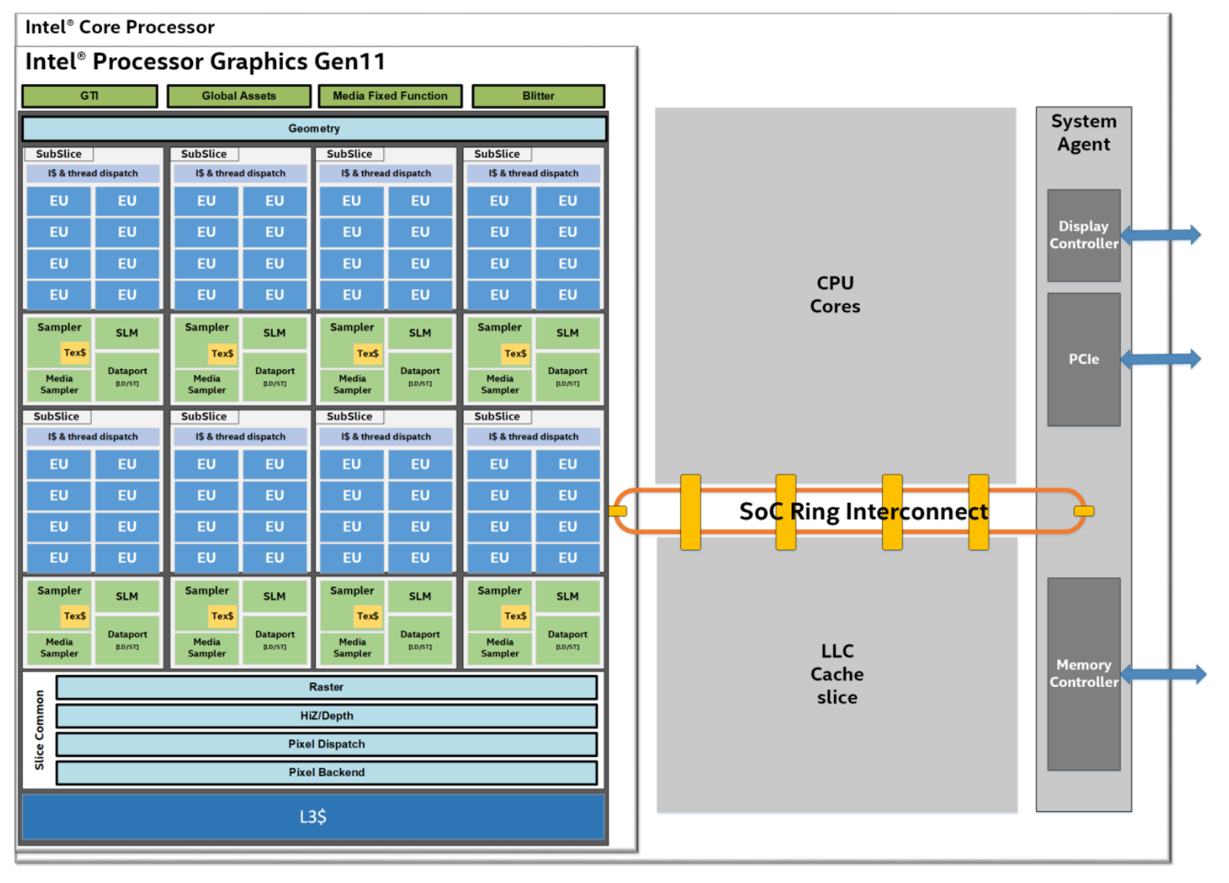
GPUs
https://www.intel.com/content/dam/develop/external/us/en/documents/the-architecture-of-intel-processor-graphics-gen11-r1new.pdf

Slide 18
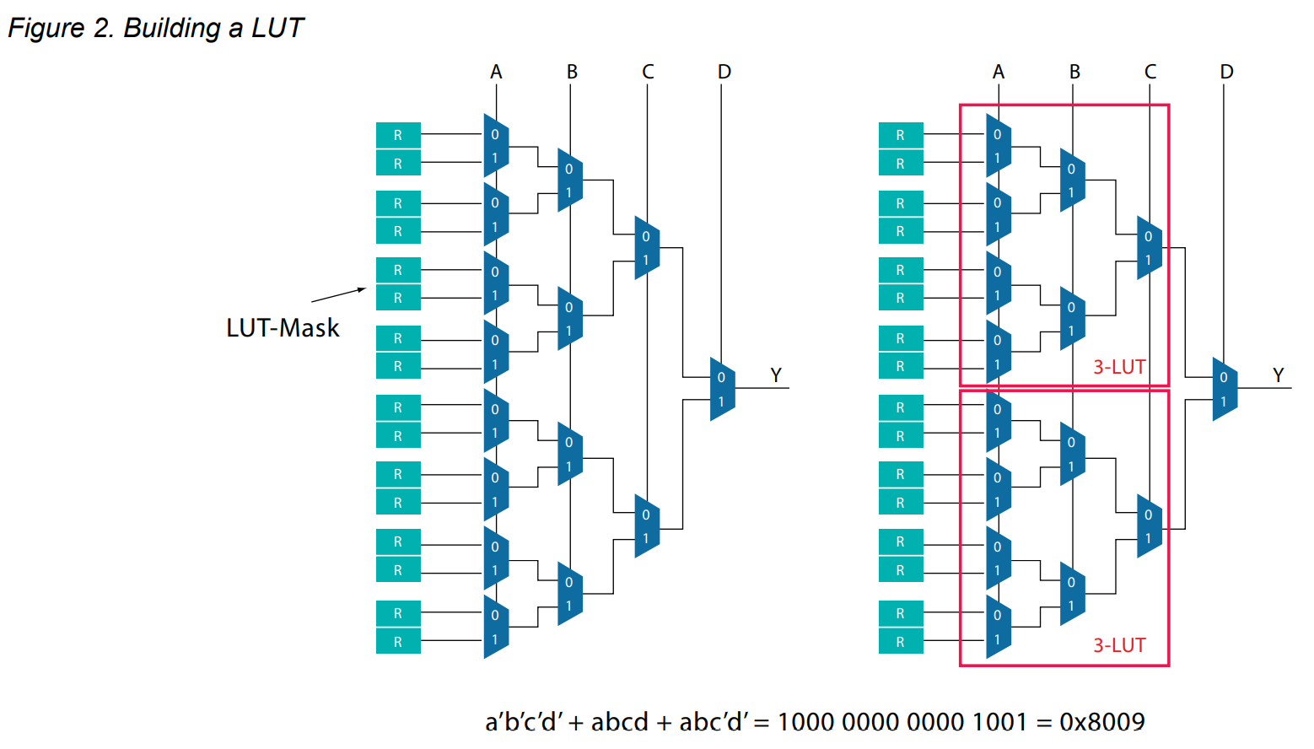
FPGAs
https://www.intel.com/content/dam/www/programmable/us/en/pdfs/literature/wp/wp-01003.pdf

Slide 19
Modern compilers
SRC
Frontend
Middle-end
Backend
Program

Slide 20
Compiler stages
Preprocessing
Lexical analysis
Frontend
Syntax analysis
Semantic analysis
IR Generation
IR Optimization
Middle-end
Code generation
Backend
Optimization

Slide 21
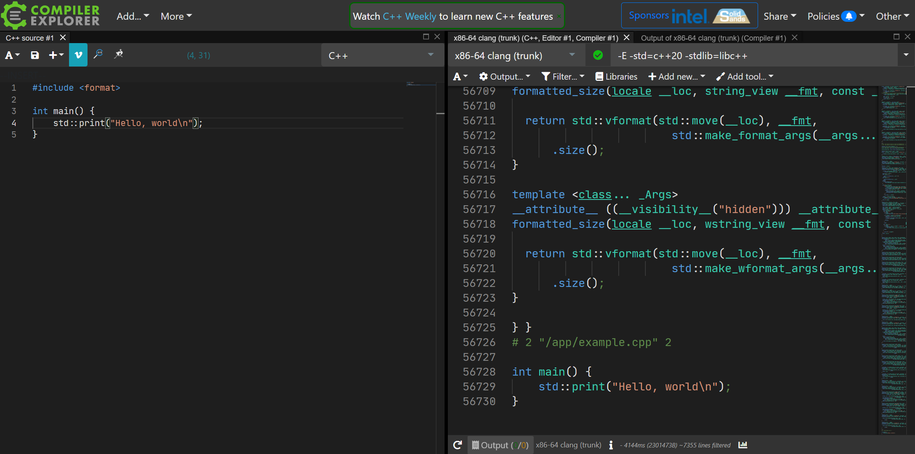
Preprocessing
https://godbolt.org/z/o4K7TYr5E

Slide 22
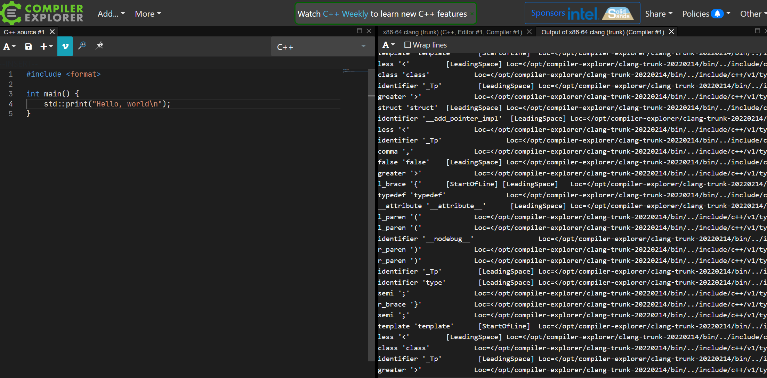
Lexer
https://godbolt.org/z/T6ejdsEba

Slide 23
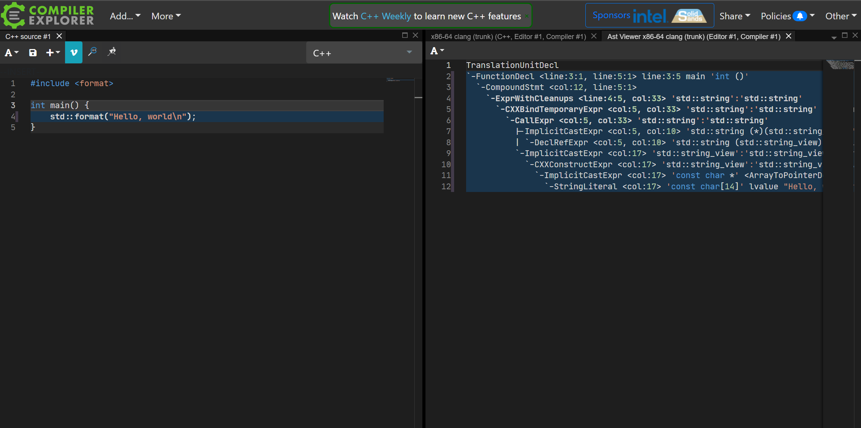
Syntax analysis
https://godbolt.org/z/cz3KjMcYb

Slide 24
Abstract Syntax Tree
FunctionDecl
ParamDecl
CompoundStmt
int foo(int i) {
if (i < 10) {
return i * 2;
}
return i;
}
https://godbolt.org/z/6Wq38MbPj
IfStmt
ReturnStmt
BinaryOperator
CompoundStmt
ReturnStmt

Slide 25
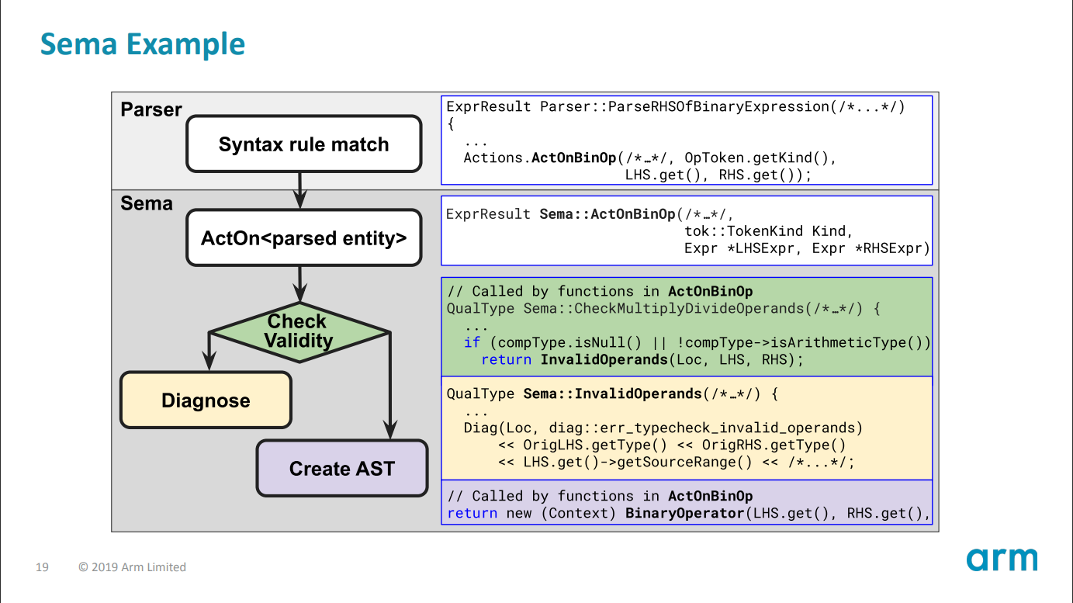
Semantic analysis
https://llvm.org/devmtg/2019-10/slides/ClangTutorial-Stulova-vanHaastregt.pdf

Slide 26
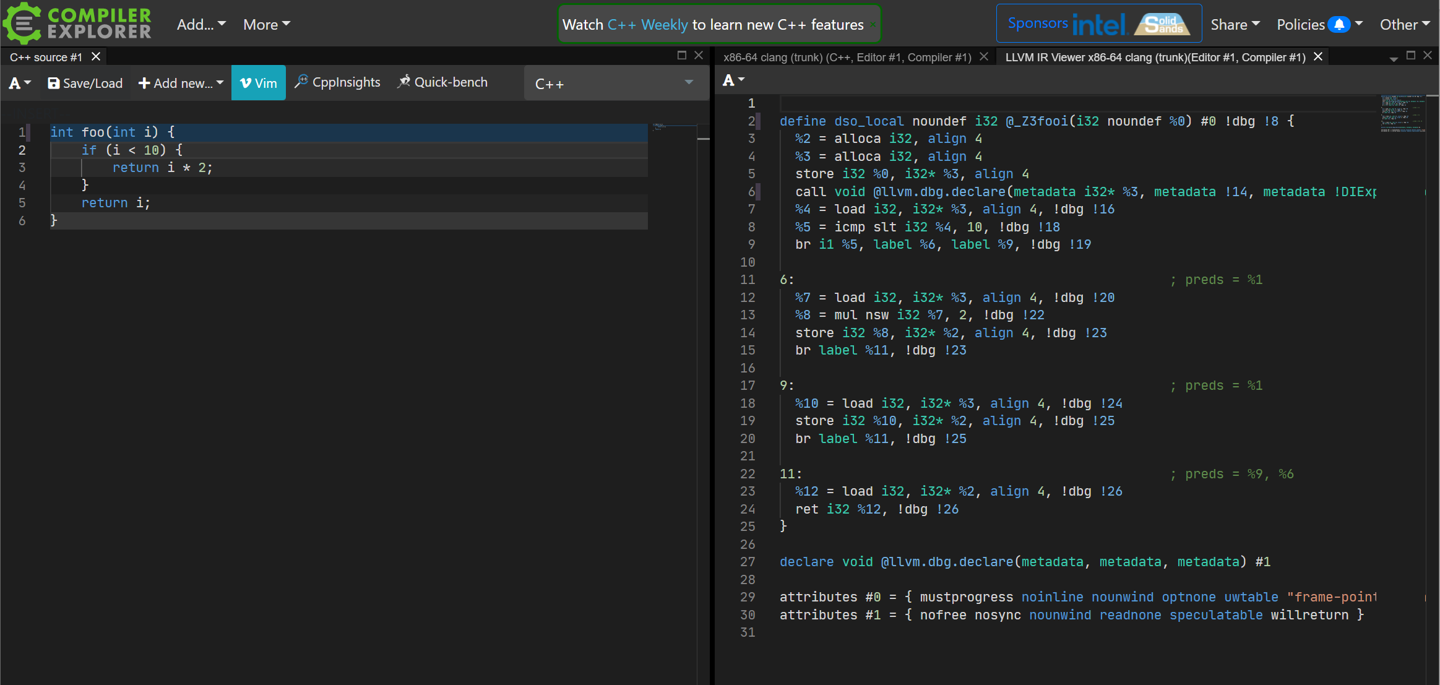
IR generation
https://godbolt.org/z/or3z3oYnq

Slide 27
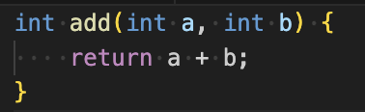
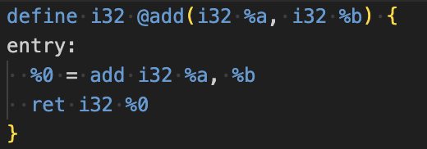
LLVM IR
C++
The corresponding LLVM IR for this function might look something like this:
LLVM
LLVM IR is used for several key purposes within the LLVM compiler framework:
Platform Independence
Optimization
Code Generation

Slide 28
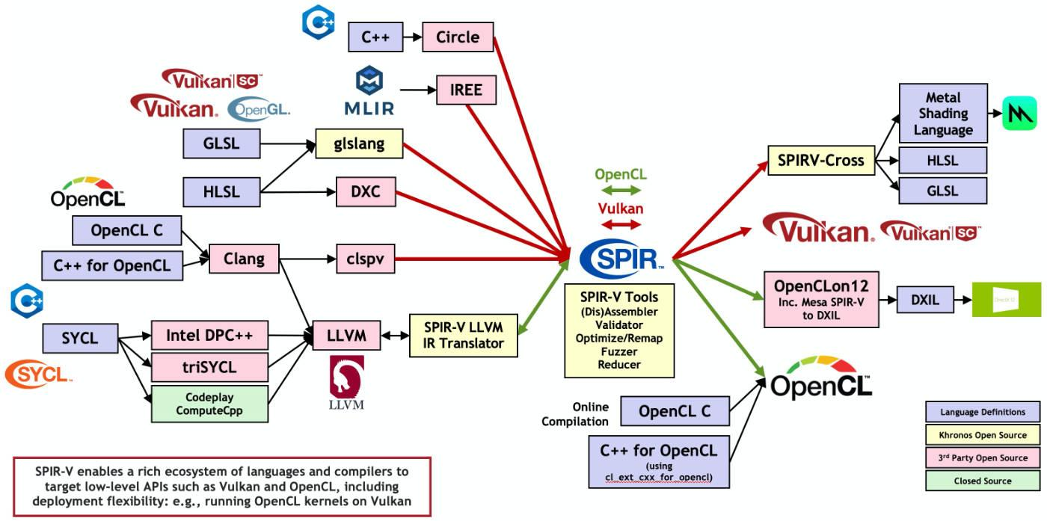
SPIR-V
https://www.khronos.org/spir/

Slide 29
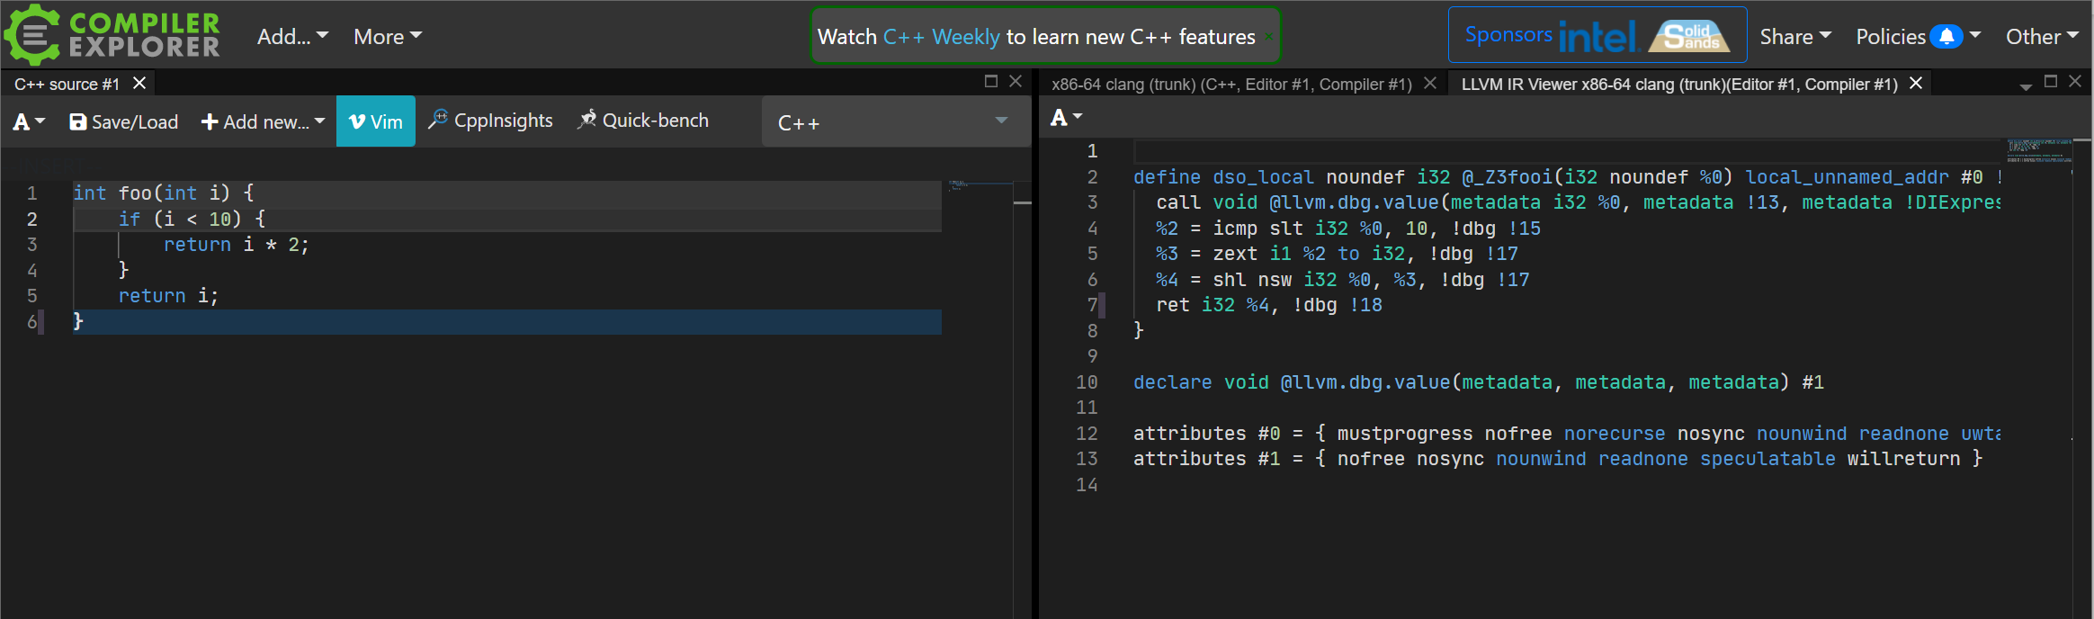
IR optimization
https://godbolt.org/z/YM6Wxno37

Slide 30
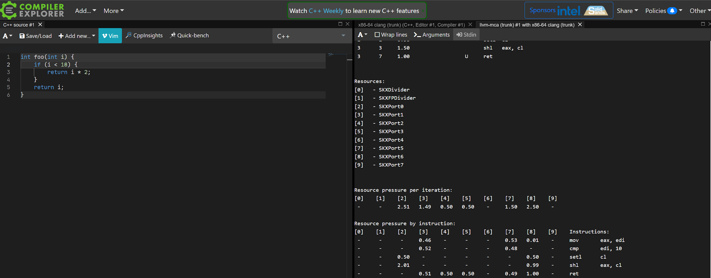
Code generation & optimization
https://godbolt.org/z/n3orv3Ydj

Slide 31
Linking
Compiler operates on Translation Units
Each translation unit produces an object file
Linker assembles multiple object files and libraries into a program
Not covered in this course
A few pointers for those, who want to know more about linkers
How the C++ Linker Works – YouTube
2017 LLVM Developers’ Meeting: R. Ueyama “lld: A Fast, Simple, and Portable Linker” - YouTube

Slide 32
Debugging
Compilers try to preserve source code <-> binary mapping
They’re not very successful when optimizations are involved
Debug info is stored in a special format within a binary or in a separate file: lookup DWARF and PDB
Debuggers get help from OS and hardware to enable breakpoints
Will be covered in this course (stretch goal)
More info:
2016 EuroLLVM Developers' Meeting: D. Panickal & A. Warzynski "LLDB Tutorial: Adding debugger ..." – YouTube
2013 LLVM Developers’ Meeting: “Adapting LLDB for your hardware: Remote Debugging the Hexagon DSP” - YouTube

Slide 33
Static analysis
Humans are not very good at computer programming
Lack of context, poor cognitive skills
ASTs and IRs can be used to help developers find bugs
Examples:
clang-tidy, PVS Studio, cppcheck, basically any IDE
More advanced: Rust borrow checker
Will be covered in this course
More info:
C++ Weekly - Ep 3 Intro to clang-tidy – YouTube
2020 LLVM Developers’ Meeting: “Using Clang-tidy for Customized Checkers and Large Scale Source...” - YouTube

Slide 34
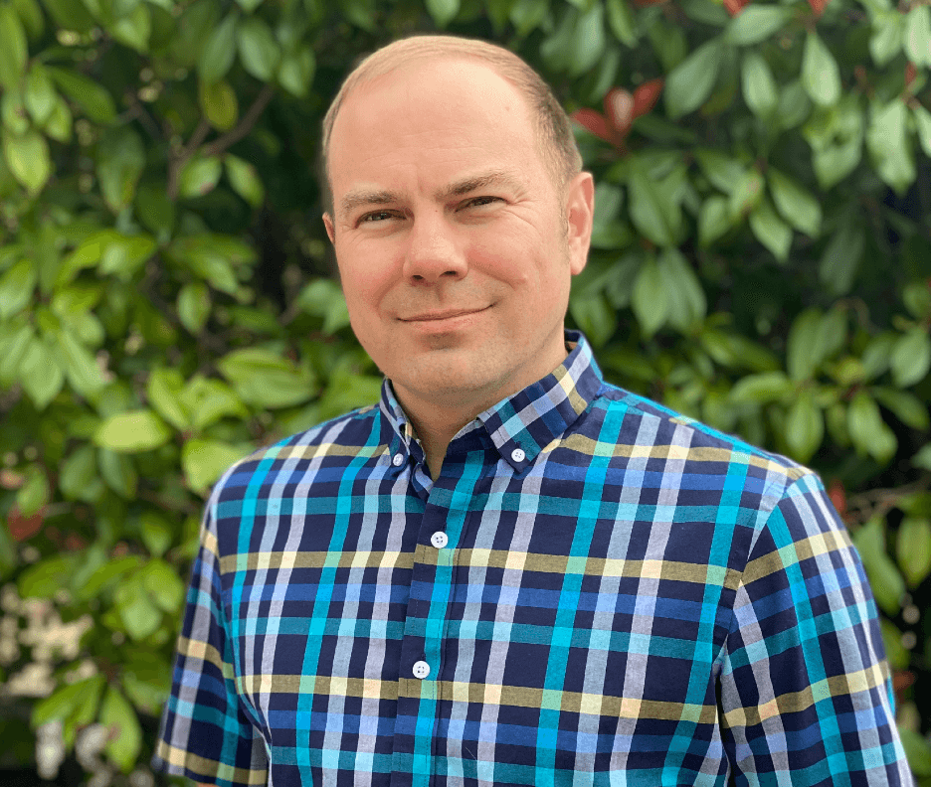
LLVM
Compiler framework
Includes LLVM IR and backends for many platforms
Started by Chris Lattner in 2001
Multiple frontends under LLVM umbrella: clang, flang
Photo: https://www.modular.ai/team

Slide 35
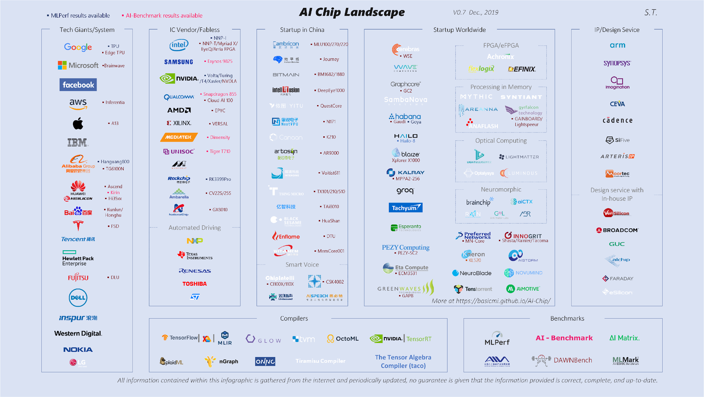
Hardware diversity
https://basicmi.github.io/AI-Chip/

Slide 36
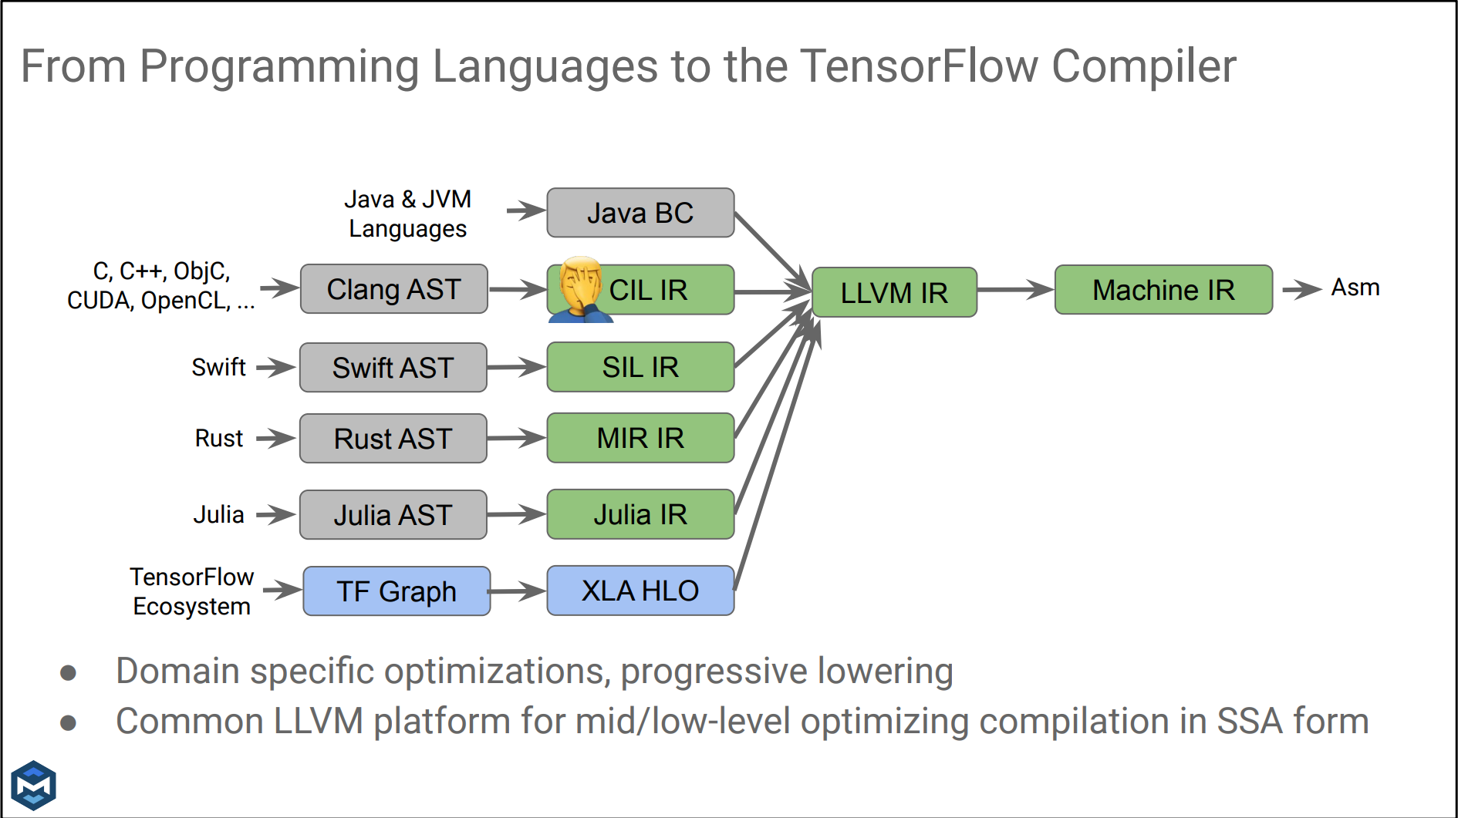
Post-modern compilers
https://llvm-hpc-2020-workshop.github.io/presentations/llvmhpc2020-amini.pdf

Slide 37
AI compilers
PyTorch
ONNX
Tensorflow
ATen dialect
ONNX dialect
TF dialect
Triton
Triton dialect
LLVM IR
Machine IR
Target HW

Slide 38
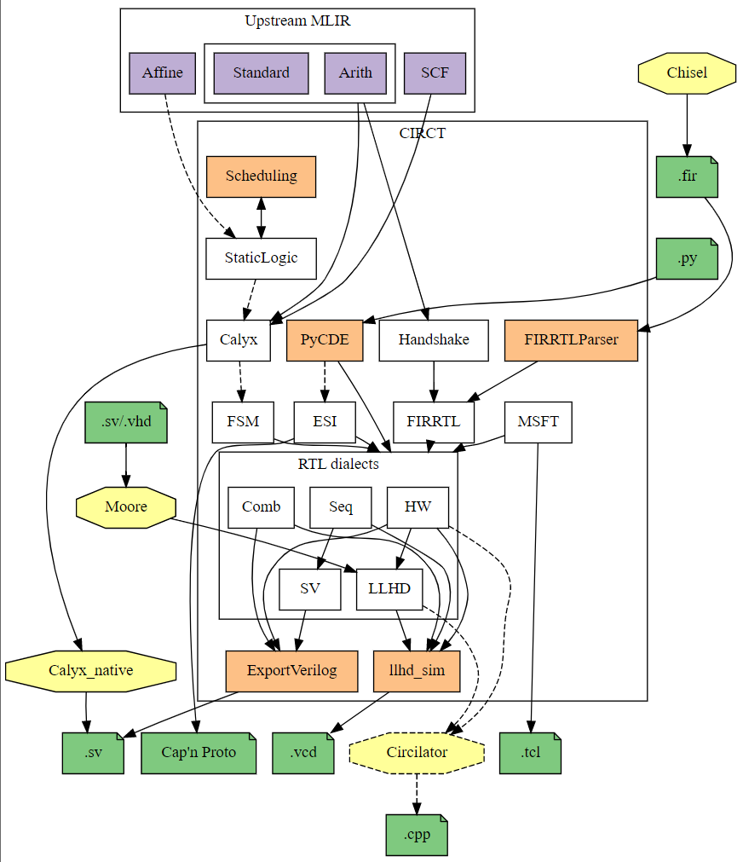
Customized hardware
“CIRCT” / Circuit IR Compilers and Tools
Compilers help design custom hardware
Reduce cost of development and validation
https://circt.llvm.org/

Slide 39
Career paths
hardware vendors
large software companies
AI development

Slide 40
In the next episode…
Compiler frontends
Different frontend stages: lexers, syntax, sema
Clang as an example

Slide 41
Extra materials
Interview with Jim Keller
Part 1: https://www.youtube.com/watch?v=Nb2tebYAaOA
Part 2: https://www.youtube.com/watch?v=G4hL5Om4IJ4
Interview with Chris Lattner
Part 1: https://www.youtube.com/watch?v=yCd3CzGSte8
Part 2: https://www.youtube.com/watch?v=nWTvXbQHwWs
An overview of Clang, LLVM Dev 2019 - https://www.youtube.com/watch?v=5kkMpJpIGYU
Compilers: Principles, Techniques, and Tools (aka the dragon book) - https://suif.stanford.edu/dragonbook/
What Has My Compiler Done for Me Lately? Matt Godbolt - https://www.youtube.com/watch?v=bSkpMdDe4g4
Chandler Carruth
Tuning C++: Benchmarks, and CPUs, and Compilers! Oh My! - https://www.youtube.com/watch?v=nXaxk27zwlk
High Performance Code 201: Hybrid Data Structures - https://www.youtube.com/watch?v=vElZc6zSIXM

